Slide 1
CS3210 Tut 4
will start at :05 as usual, read on Bitonic Sort first (check telegram group)
Quiz 1 & 2 Review + Some Assignment 2 & CUDA extras
Slides yoinked from Zhi Heng, which was adapted from Prof Cristina's

Slide 2
Quiz 1

Slide 3
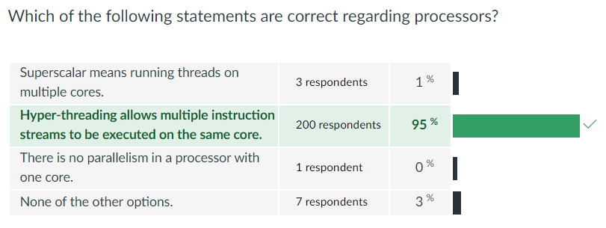

Slide 4
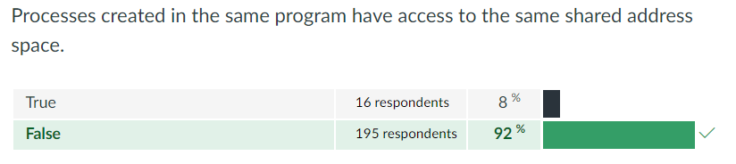

Slide 5
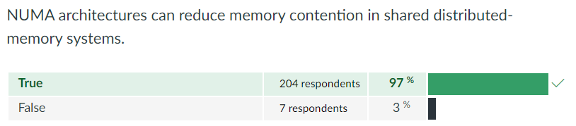

Slide 6
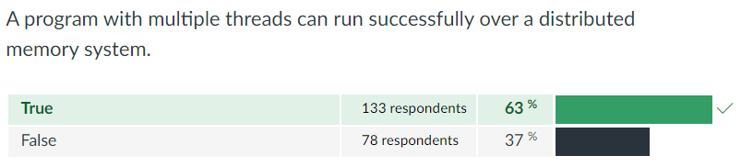

Slide 7
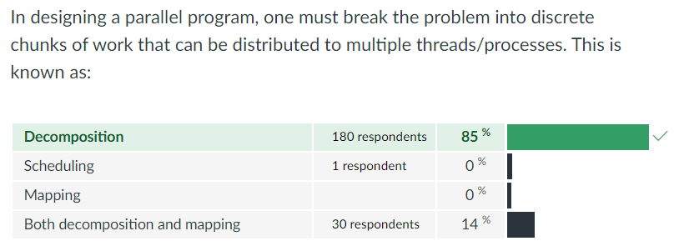

Slide 8
Quiz 2

Slide 9
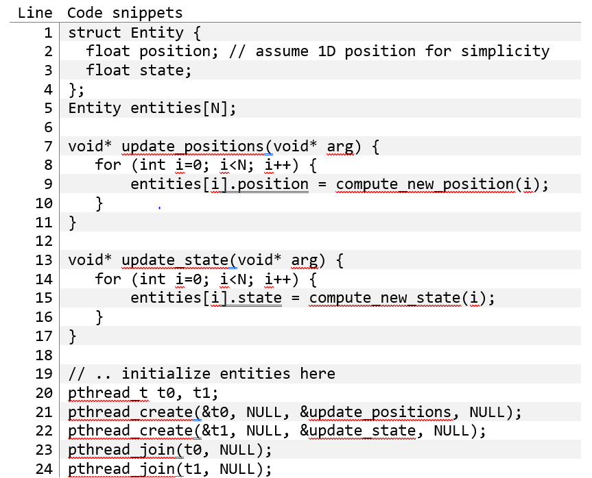
Q1+2
Understanding the problem

Slide 10
Q1+2
Understanding the problem
Two threads, both updating values within an array of structs
For each struct,
One thread changes the position variable
One thread changes the state variable

Slide 11
Q1
Why don't we get 2x speedup?

Slide 12
Q1
Why don't we get 2x speedup?
Classic false sharing
Both threads (if running at the same rate) are writing to the same entity
That's OK, but position and state are (likely) part of the same cache line!!

Slide 13
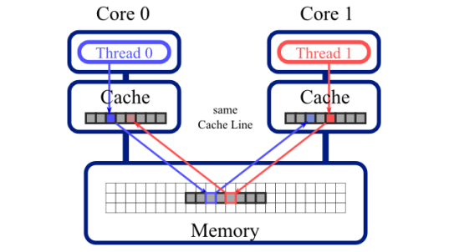
Recap: False Sharing
Two cores update different data that happens to be part of the same cache line!
Due to cache coherence, the data must be written back to memory, and then written to the other core's cache, even if not strictly needed!

Slide 14
Q2
How to solve (at least 3 ideas)?

Slide 15
Q2
How to solve (at least 3 ideas)?
Have two separate arrays:
float position[N]
float state[N]

Slide 16
Q2
How to solve (at least 3 ideas)?
Have two separate arrays:
float position[N]
float state[N]
Have padding between position and state to put them in diff cache lines
e.g. add a field like char pad[PAD_BYTES]

Slide 17
Q2
How to solve (at least 3 ideas)?
Have two separate arrays:
float position[N]
float state[N]
Have padding between position and state to put them in diff cache lines
e.g. add a field like char pad[PAD_BYTES]
Make one thread iterate 0 → N the other thread iterate N/2 → wraparound to 0 → N/2-1

Slide 18
Matrix Multiplication in OpenMP and CUDA
We discussed the matrix multiplication problem in many contexts in this course.
Assume you are required to implement two programs, one in OpenMP and another one is CUDA that do matrix multiplication for two large square matrices. The matrices are stored in two files and they do not fit in memory (i.e. both the host memory and the device memory are unable to store the entirety of a single matrix). The result is computed and stored in a file.
Assume that the computers (machines) used for all questions below have similar performance to the computers you used to do your assignments.

Slide 19
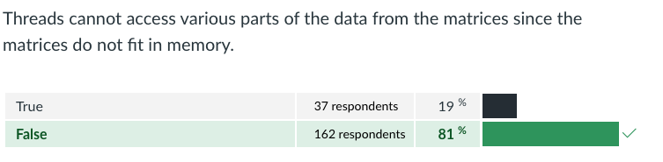
If you try to run a classic matrix multiplication implementation in OpenMP (like the one we used in Lab 2), you will experience some issues. Are the following statements true or false?

Slide 20
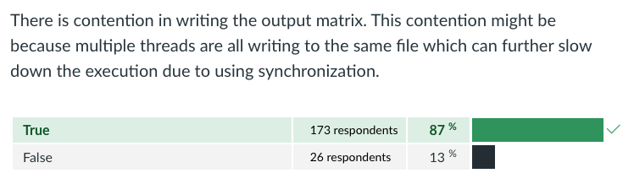
If you try to run a classic matrix multiplication implementation in OpenMP (like the one we used in Lab 2), you will experience some issues. Are the following statements true or false?

Slide 21
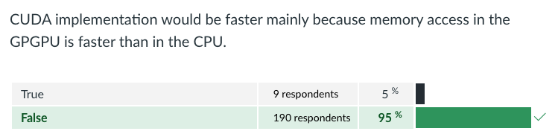
Which of the two matrix multiplication classic implementations (OpenMP and CUDA) do you expect to have better performance (i.e. smaller execution time) in the scenario provided above and why?
Are the following statements true or false?

Slide 22
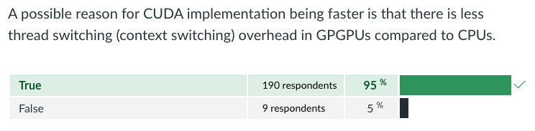
Which of the two matrix multiplication classic implementations (OpenMP and CUDA) do you expect to have better performance (i.e. smaller execution time) in the scenario provided above and why?
Are the following statements true or false?

Slide 23
Additional Question 1
Relaxed consistency models address the concern that software complexity is increased by the need for unnecessary synchronization.

Slide 24
Additional Question 1
Relaxed consistency models address the concern that software complexity is increased by the need for unnecessary synchronization.
False: relaxed consistency does not address software complexity
Relaxed consistency exists to increase performance of programs (i.e. allows programmers to write faster code)
Doing so can actually increase the software complexity even further!

Slide 25
Additional Question 2
Cache coherence is the property that multiple caches contain the same set of items. Is this statement true or false?

Slide 26
Additional Question 2
Cache coherence is the property that multiple caches contain the same set of items. Is this statement true or false?
False: Caches do not have to contain the same set of items.
We just need to make sure that the specific cache lines that is being accessed by multiple processes is in sync

Slide 27
Lab 3: GPU Sum

Slide 28
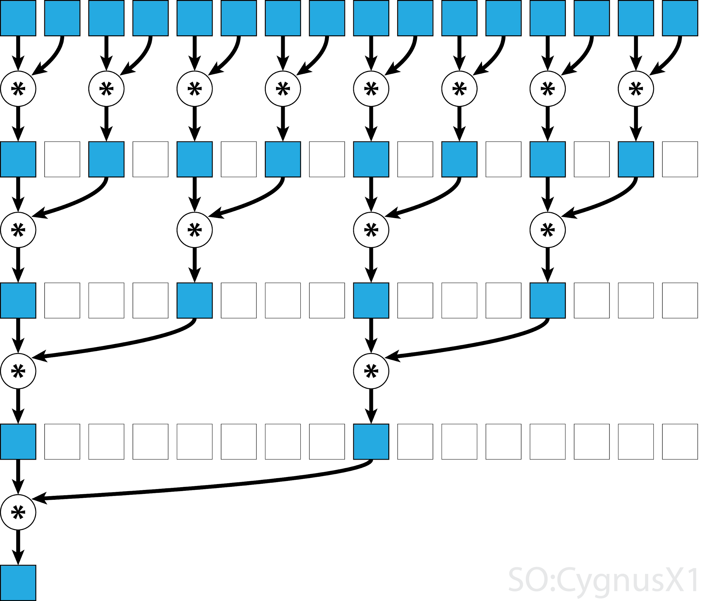
Lab3: GPU Sum – diff methods
Atomic add:
all threads atomically add to a global variable
Atomic shared
threads add to block-shared variable
then finally to global variable
Reduce shared
Threads combine values in a block-shared array
Each step, half the threads from prev step are involved
One last atomic add at the end
Notes:
t3-demo

Slide 29
Extra Topic: Bitonic Sort in CUDA

Slide 30
Bitonic Sort (PYP question)
Great algorithm for massively parallel sorting
Relies on merging bitonic sequences: a series of numbers that are
Increasing for the first half
Decreasing for the second half
O(n log² n) ⇒ Slower than the fastest sorts serially, but massively parallel

Slide 31
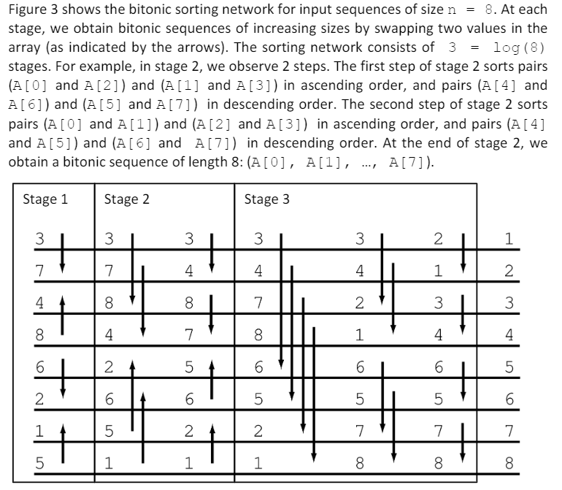
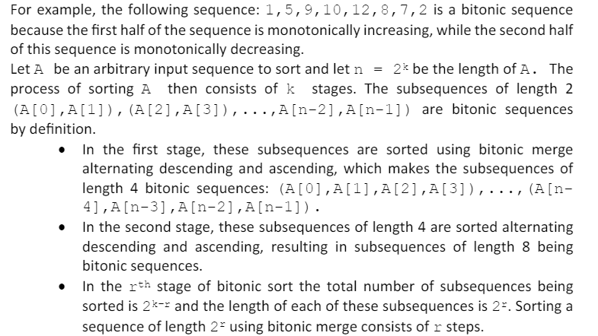
Bitonic Sort: PYP

Slide 32
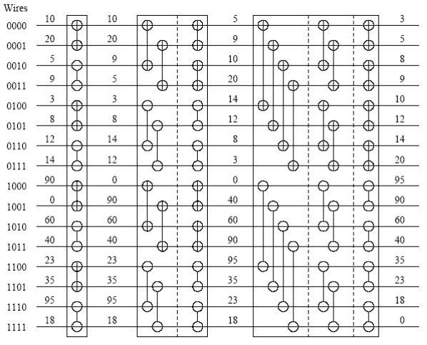
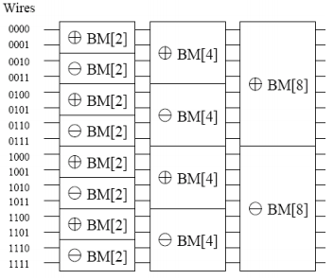
CUDA?
Why is this parallelizable and ideal for CUDA?

Slide 33
CUDA?
Same no. of threads (N/2) doing same no. of comparisons in each step!

Slide 34
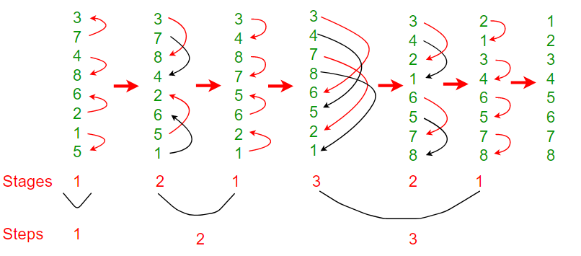
More intuition
Observe: 4 comparisons in each “step”, N / 2, same each time
Completely independent data in each step

Slide 35
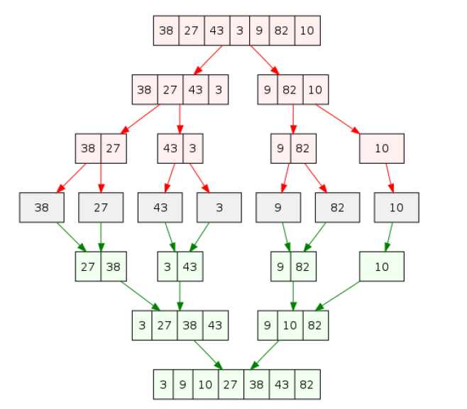
Comparison to Merge Sort
Why is Merge Sort not preferred (compared to Bitonic Sort) for parallel implementations?

Slide 36
Comparison to Merge Sort
Why is Merge Sort not preferred (compared to Bitonic Sort) for parallel implementations?
Total task number changes at each state
Task granularity changes at each state
Merging cannot be parallelized
Temporary arrays have to be synchronized correctly

Slide 37

End of tutorial 3
Slides uploaded!
If your attendance has not been marked, lmk
Feedback: bit.ly/feedback-theodore or scan below
Email: theo@comp.nus.edu.sg

